Slide 1
Physical Fitness Leave Process

Slide 2
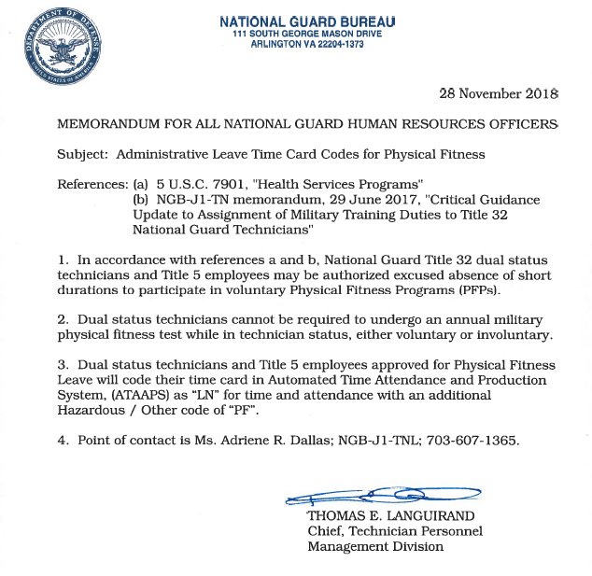

Slide 3
FIRST: Submit Leave Request
LN with sub-code PF

Slide 4
Insert a row of Administrative Leave – LN and add the hours on the correct day for any days Physical Fitness was done.
Also, insert your remaining labor for the rest of the pay period and Save.

Slide 5
Now, to add the code of PF – Physical Fitness, Click the NtDiff/Haz/Oth Button.

Slide 6
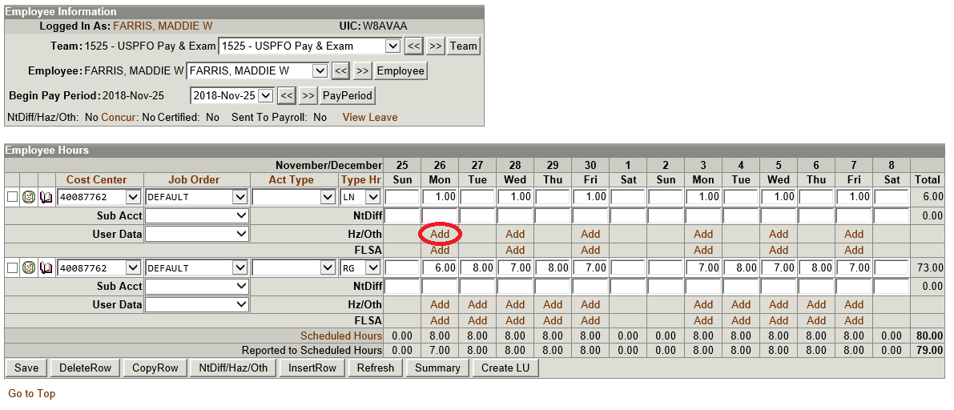
Once you select the NitDiff/Haz/Oth Button, you will see all these multiple rows pop up under the Administrative Leave – LN row that you created. Directly underneath the LN hours is the word Add. You will click the word Add to add the code of PF – Physical Fitness to those hours.

Slide 7
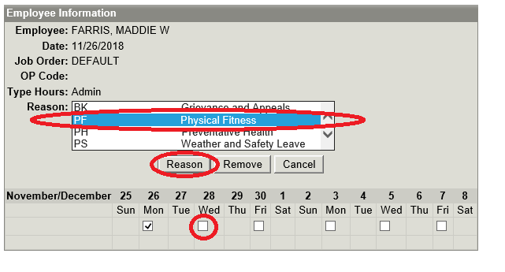
After selecting the word Add, you will be taken to a screen that looks like this. In the Reason box, find and select PF – Physical Fitness, check all boxes for the days this code applies to, and then click the Reason button.

Slide 8
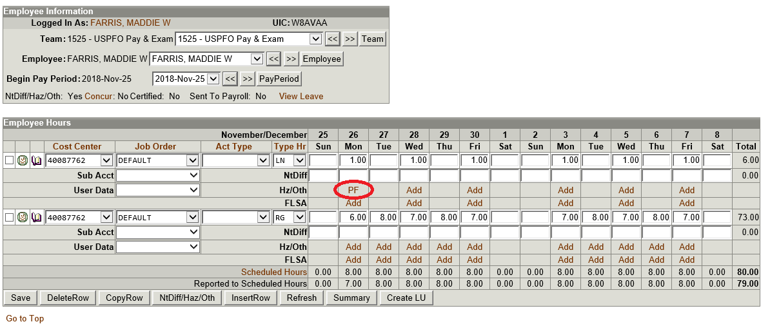
Now you will be taken back to your labor screen where you will see that the code for PF – Physical Fitness has been added. You can now concur your labor.

Slide 9
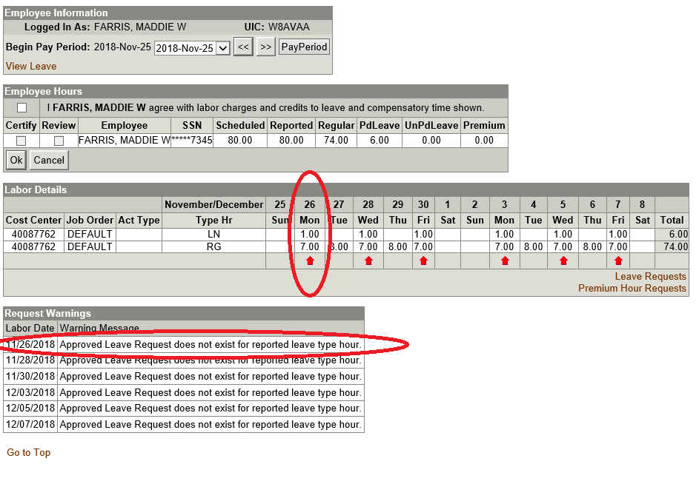
You will see a Request Warning because an Approved Leave Request does not exist.
One Leave Request per hour of LN/PF. For the example, there would be 6 leave requests for 1 hour each.

